Slide 1
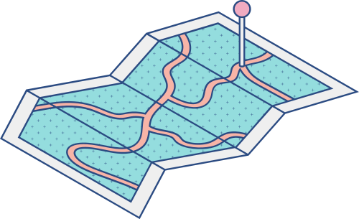





DESAIN & MANAJEMEN
JARINGAN KOMPUTER (B)
Final Project
Desain Manajemen Jaringan
Komputer

Slide 2


Kelompok 1
DMJK B
1
2
3
PUTRI DWI ISABELLA
FEBINA MUSHEN ANJELITA
ELLION BLESSAN
5026201036
5026201098
5026201130

Slide 3



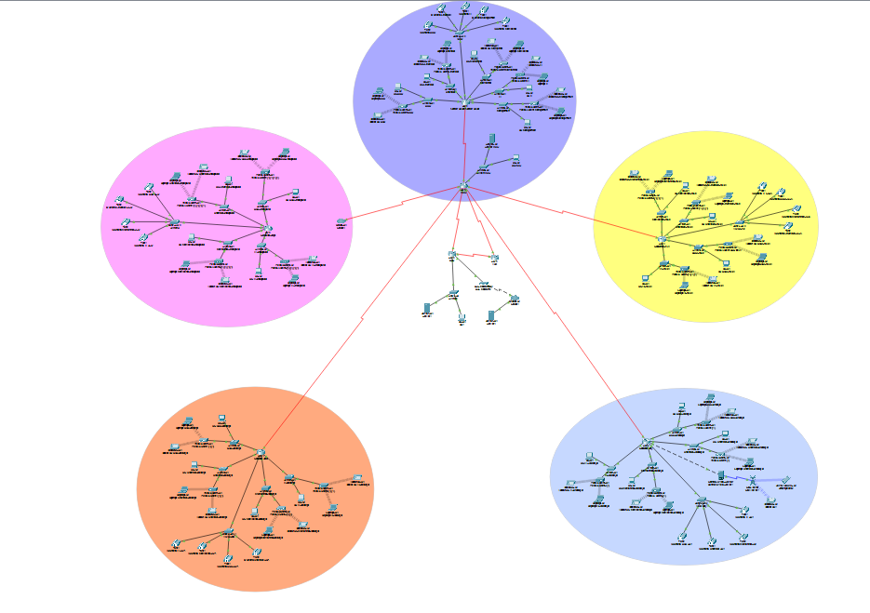
Desain Topologi

Slide 4
Keterangan Desain Topologi
Kantor Pusat Surabaya
Kantor Cabang Dalam Kota Surabaya
Kantor Cabang Luar Kota Sidoarjo
Kantor Cabang Luar Kota Gersik
Kantor Cabang Luar Negeri Singapura
DRC (Disaster Recovery Center)
Subnet Mask (255.255.255.0)
DNS Server (192.168.50.1)

Slide 5

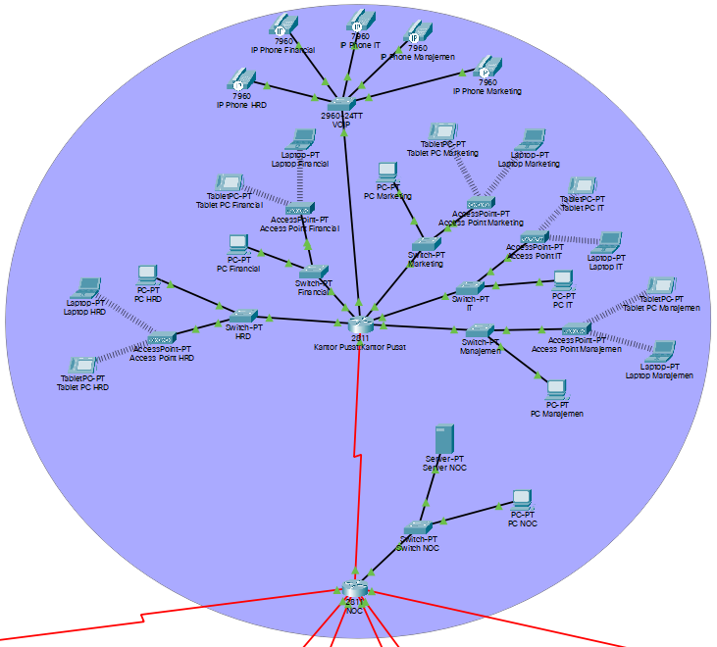
Desain Topologi (Kantor Pusat)

Slide 6
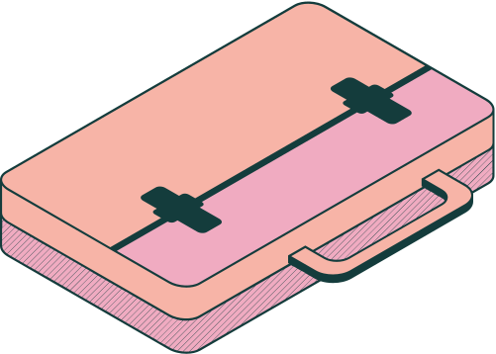
Keterangan Topologi
(Kantor Pusat)
Router Kantor Pusat
(Serial0/0/0 (192.168.36.1))
Switch HRD Lantai 1 FastEthernet0/0 (192.168.1.1)
PC HRD (192.168.1.2 (IP DHCP))
Access Point HRD
Laptop HRD (192.168.1.4 (IP DHCP))
Tablet PC HRD (192.168.1.3 (IP DHCP))
Switch Financial Lantai 2 FastEthernet1/0 (192.168.2.1)
PC Financial (192.168.2.2 (IP DHCP))
Access Point Financial
Laptop HRD (192.168.2.3 (IP DHCP))
Tablet PC HRD (192.168.2.4 (IP DHCP))
Switch Marketing Lantai 3 FastEthernet 7/0 (192.168.3.1)
PC Marketing (192.168.3.2 (IP DHCP))
Access Point Marketing
Laptop HRD (192.168.3.4 (IP DHCP))
Tablet PC HRD (192.168.3.3 (IP DHCP))
Switch IT Lantai 4 FastEthernet 8/0 (192.168.4.1)
PC IT (192.168.4.3 (IP DHCP))
Access Point IT
Laptop HRD (192.168.4.4 (IP DHCP))
Tablet PC HRD (192.168.4.2 (IP DHCP))
Switch Manajemen Lantai 5 FastEthernet 6/0 (192.168.5.1)
PC Manajemen (192.168.5.3 (IP DHCP))
Access Point Manajemen
Laptop HRD (192.168.5.4 (IP DHCP))
Tablet PC HRD (192.168.5.2 (IP DHCP))
Switch VOIP
DHCP Net 192.168.200.0
Dial Number : 101 - 105

Slide 7
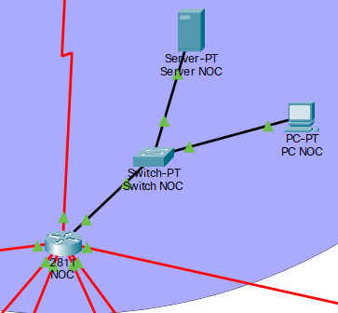
Keterangan Topologi Kantor Pusat (Surabaya)
Router NOC
FastEthernet0/0 (192.168.50.2)
Serial1/0 (192.168.36.2)
Serial1/1 (192.168.130.1)
Serial1/2 (192.168.98.2)
Serial1/3 (192.168.89.1)
Serial 1/4 (192.168.63.1)
Serial1/5 (192.168.150.1)
PC-PT NOC (192.168.50.3 DHCP)
Server-PT NOC (192.168.50.1 DHCP)

Slide 8
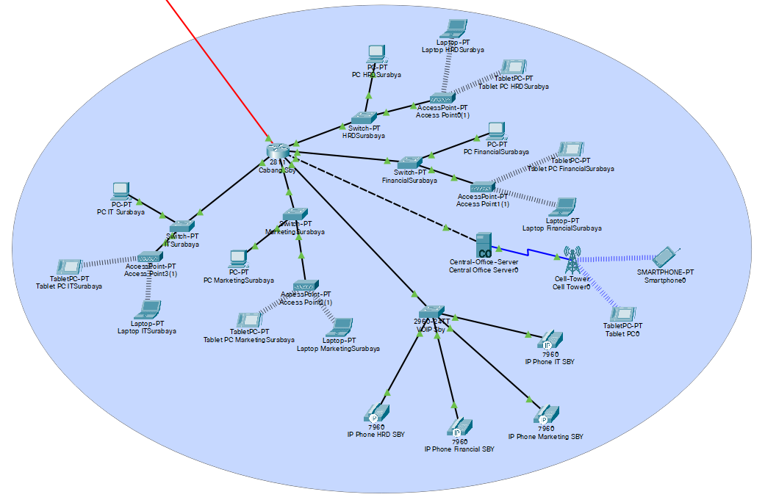
Kantor Cabang Surabaya

Slide 9
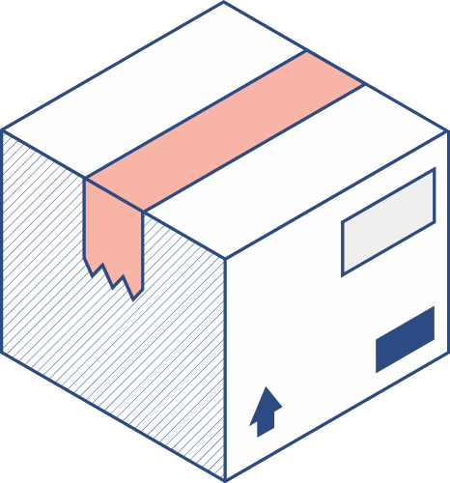

Keterangan Topologi (Kantor Cabang Dalam Kota Surabaya)
Router Kantor Cabang Surabaya
(Serial0/0/0 (192.168.130.2))
Switch HRD Lantai 1 FastEthernet0/0 (192.168.6.1)
PC HRD (192.168.6.2 (IP DHCP))
Access Point HRD
Laptop HRD (192.168.6.3 (IP DHCP))
Tablet PC HRD (192.168.6.4 (IP DHCP))
Switch Financial Lantai 2 FastEthernet1/0 (192.168.7.1)
PC Financial (192.168.7.2 (IP DHCP))
Access Point Financial
Laptop HRD (192.168.7.4 (IP DHCP))
Tablet PC HRD (192.168.7.3 (IP DHCP))
Switch Marketing Lantai 3 FastEthernet 6/0 (192.168.8.1)
PC Marketing (192.168.8.2 (IP DHCP))
Access Point Marketing
Laptop HRD (192.168.8.4 (IP DHCP))
Tablet PC HRD (192.168.8.3 (IP DHCP))
Switch IT Lantai 4 FastEthernet 7/0 (192.168.9.1)
PC IT (192.168.9.2 (IP DHCP))
Access Point IT
Laptop HRD (192.168.9.3 (IP DHCP))
Tablet PC HRD (192.168.9.4 (IP DHCP))
Switch VOIP
DHCP Net (192.168.101.0)
Dial Num (201-204)

Slide 10
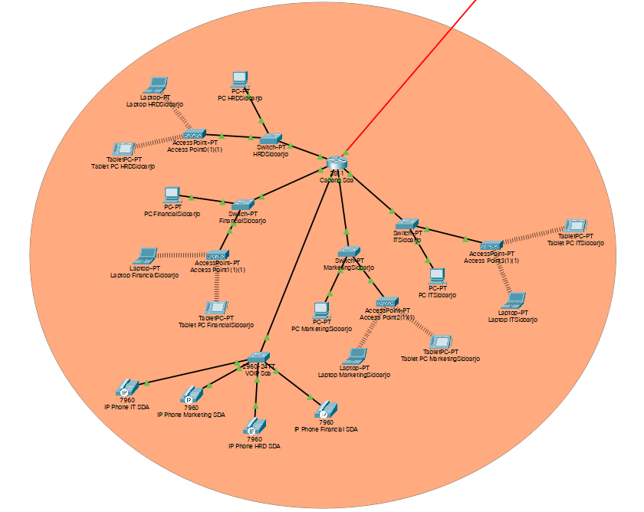
Kantor Cabang Sidoarjo

Slide 11



Desain Topologi
(Kantor Cabang Luar Kota Sidoarjo)
Router Kantor Cabang Surabaya
(Serial0/0/0 (192.168.98.1))
Switch HRD Lantai 1 FastEthernet0/0 (192.168.10.1)
PC HRD (192.168.10.3 (IP DHCP))
Access Point HRD
Laptop HRD (192.168.10.4 (IP DHCP))
Tablet PC HRD (192.168.10.2 (IP DHCP))
Switch Financial Lantai 2 FastEthernet0/1 (192.168.11.1)
PC Financial (192.168.11.3 (IP DHCP))
Access Point Financial
Laptop HRD (192.168.11.4 (IP DHCP))
Tablet PC HRD (192.168.11.2 (IP DHCP))
Switch Marketing Lantai 3 FastEthernet 1/0 (192.168.12.1)
PC Marketing (192.168.12.3 (IP DHCP))
Access Point Marketing
Laptop HRD (192.168.12.4 (IP DHCP))
Tablet PC HRD (192.168.12.2 (IP DHCP))
Switch IT Lantai 4 FastEthernet 1/1 (192.168.13.1)
PC IT (192.168.13.2 (IP DHCP))
Access Point IT
Laptop HRD (192.168.13.4 (IP DHCP))
Tablet PC HRD (192.168.13.3 (IP DHCP))
Switch VOIP
DHCP Net 192.168.102.0
Dial Number : 301 - 304

Slide 12
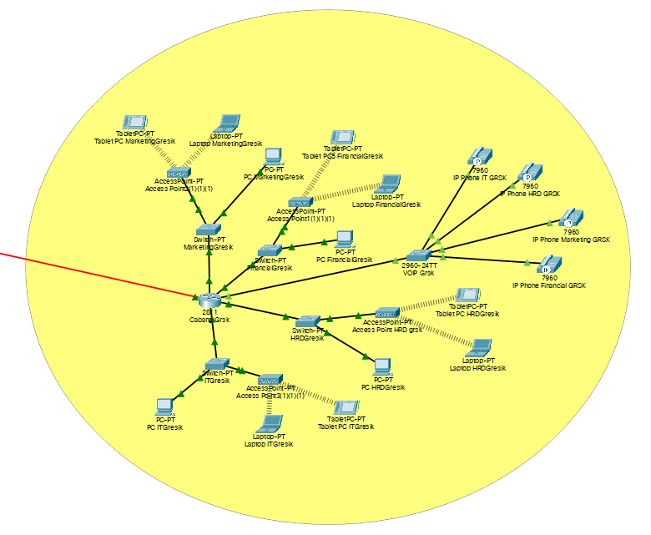
Kantor Cabang Gresik

Slide 13

Keterangan Topologi
(Kantor Cabang Luar Kota Gresik)
Switch Financial Lantai 2 FastEthernet1/0 (192.168.15.1)
PC Financial (192.168.15.3 (IP DHCP))
Access Point Financial
Laptop HRD (192.168.15.4 (IP DHCP))
Tablet PC HRD (192.168.15.2 (IP DHCP))
Switch Marketing Lantai 3 FastEthernet 6/0 (192.168.16.1)
PC Marketing (192.168.16.2 (IP DHCP))
Access Point Marketing
Laptop HRD (192.168.16.4 (IP DHCP))
Tablet PC HRD (192.168.16.3 (IP DHCP))
Switch IT Lantai 4 FastEthernet 7/0 (192.168.17.1)
PC IT (192.168.17.2 (IP DHCP))
Access Point IT
Laptop HRD (192.168.17.3 (IP DHCP))
Tablet PC HRD (192.168.17.4 (IP DHCP))
Router Kantor Cabang Gresik
(Serial0/0/0 (192.168.89.2))
Switch HRD Lantai 1 FastEthernet0/0 (192.168.14.1)
PC HRD (192.168.14.2 (IP DHCP))
Access Point HRD
Laptop HRD (192.168.14.3 (IP DHCP))
Tablet PC HRD (192.168.14.4 (IP DHCP))
Switch VOIP
DHCP Net 192.168.103.0
Dial Number : 402 - 404

Slide 14
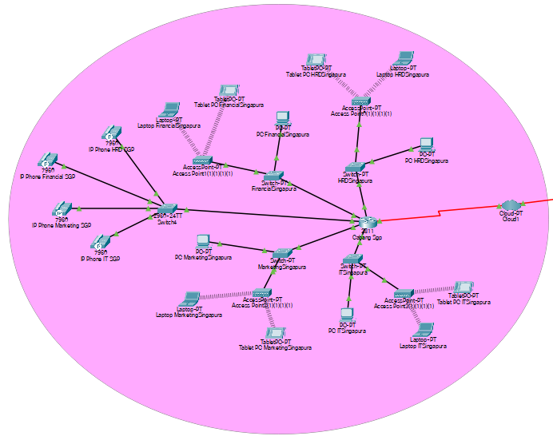
Kantor Cabang Singapura

Slide 15

Keterangan Topologi
(Kantor Cabang Luar Negeri Singapura)
Cabang terhubung melalui cloud
Router Kantor Cabang Singapura
Serial0/0/0 (192.168.63.2)
Switch HRD Lantai 1 FastEthernet0/0 (192.168.18.1)
PC HRD (192.168.18.2 (IP DHCP))
Access Point HRD
Laptop HRD (192.168.18.3 (IP DHCP))
Tablet PC HRD (192.168.18.4 (IP DHCP))
Switch Financial Lantai 2 FastEthernet1/0 (192.168.19.1)
PC Financial (192.168.19.2 (IP DHCP))
Access Point Financial
Laptop HRD (192.168.19.4 (IP DHCP))
Tablet PC HRD (192.168.19.3 (IP DHCP))
Switch Marketing Lantai 3 FastEthernet 6/0 (192.168.20.1)
PC Marketing (192.168.20.2 (IP DHCP))
Access Point Marketing
Laptop HRD (192.168.20.3 (IP DHCP))
Tablet PC HRD (192.168.20.4 (IP DHCP))
Switch IT Lantai 4 FastEthernet 7/0 (192.168.21.1)
PC IT (192.168.21.3 (IP DHCP))
Access Point IT
Laptop HRD (192.168.21.4 (IP DHCP))
Tablet PC HRD (192.168.21.2 (IP DHCP))
Switch VOIP
DHCP Net 192.168.104.0
Dial Number : 501 - 504

Slide 16
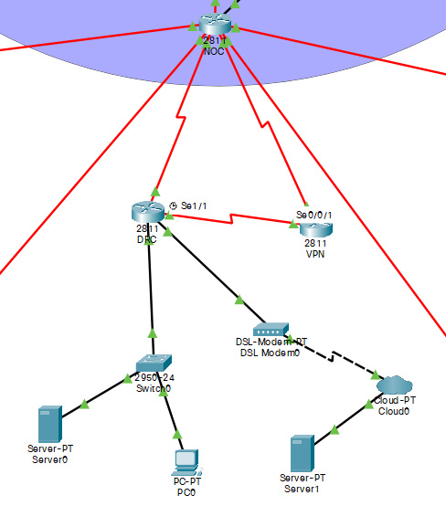
Desain Topologi
DRC (Disaster Recovery Center)

Slide 17
Keterangan Topologi
DRC (Disaster Recovery Center)
PC DRC
IP Address 192.168.151.2
Default Gateway 192.168.151.1
DNS Server 192.168.151.3
Subnet Mask 255.255.255.0
Router DRC
FastEthernet0/0 192.168.152.1
FastEthernet0/1 192.168.151.1
Serial1/0 192.168.150.2
Serial1/1 192.168.153.2
Server0 DRC
IP address 192.168.151.3
Default Gateway 192.168.151.1
Subnet Mask 255.255.255.0
Server1 DRC
IP address 192.168.152.2
Default Gateway 192.168.152.1
Subnet Mask 255.255.255.0
DNS Server 192.168.151.2

Slide 18
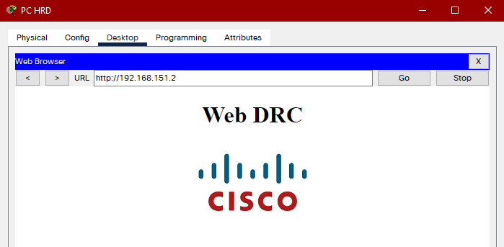
Web DRC

Slide 19
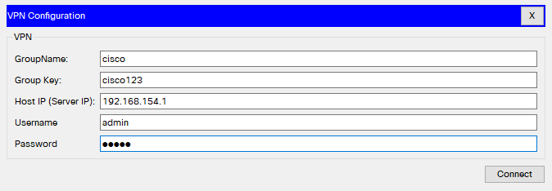
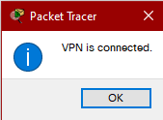
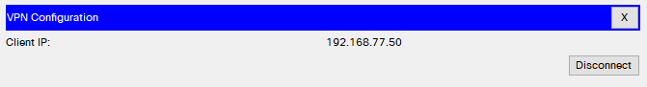
Keterangan Topologi
VPN (Virtual Private Network)

Slide 20

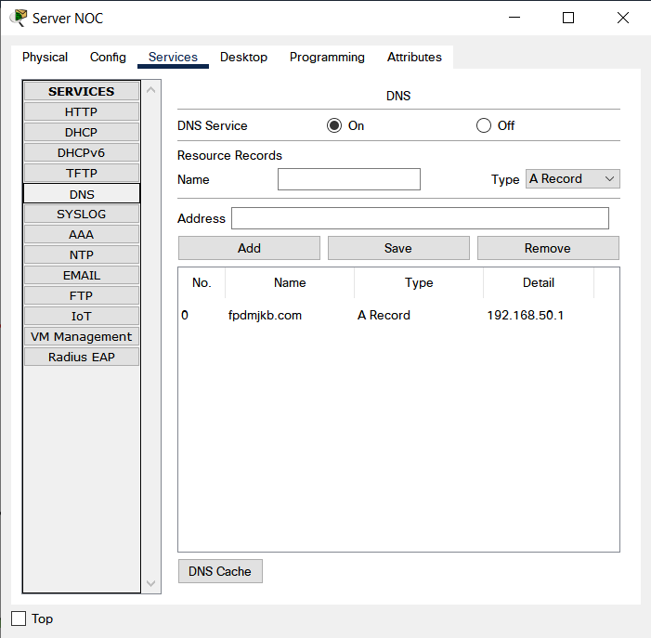

DNS (Domain Name Server)
DNS dapat diakses oleh semua device di kantor pusat dan seluruh kantor cabang dengan menggunakan fpdmjkb.com yang telah diaktifkan di NOC Server

Slide 21

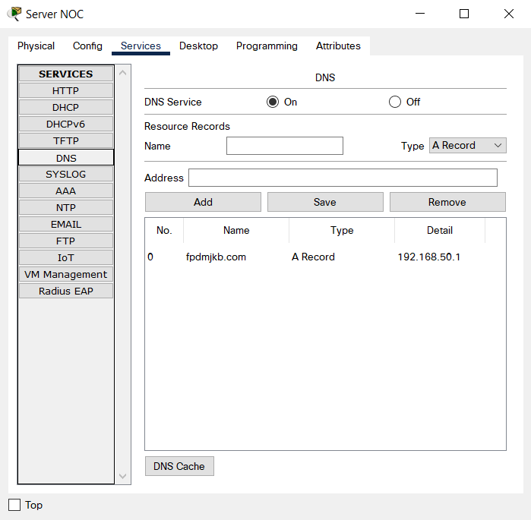
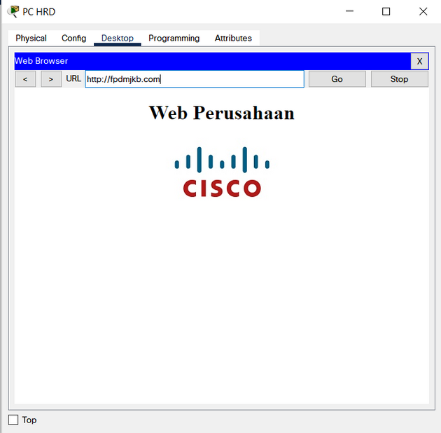
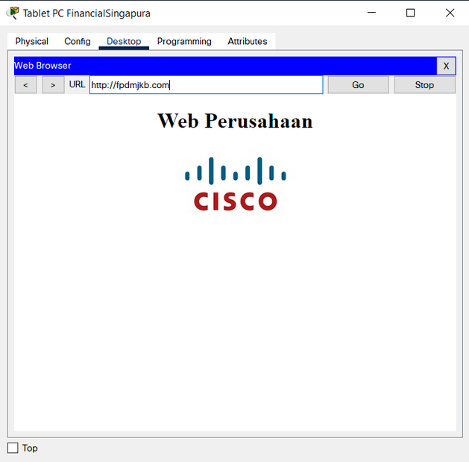
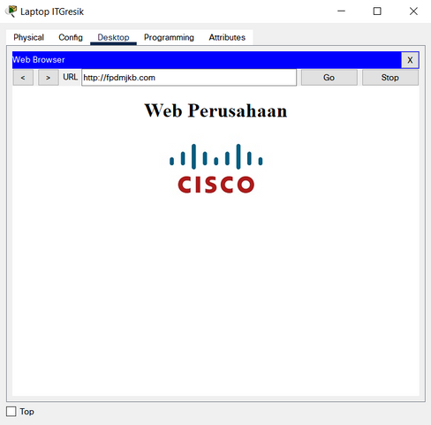


WEBSITE (Web Server) Perusahaan
Web perusahaan dapat diakses oleh semua device di kantor pusat dan seluruh kantor cabang yang telah diatur di server NOC dengan domain name fpdmjkb.com

Slide 22

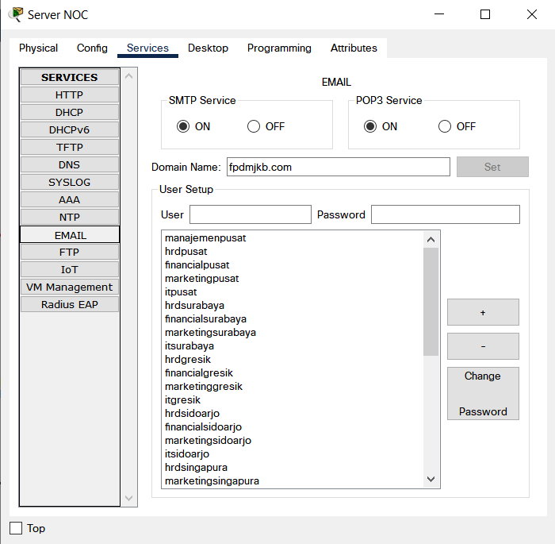
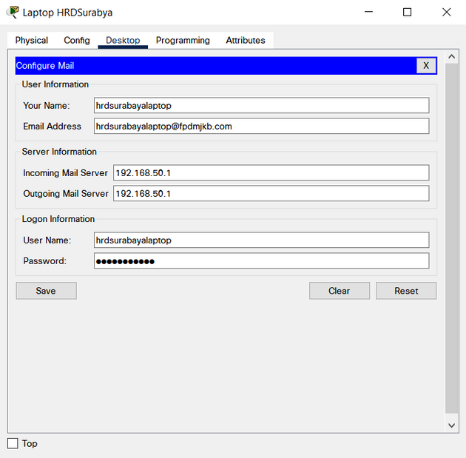

Mail Server
Mail Server diatur di Server NOC dengan domain fpdmjkb.com dapat diakses oleh semua device di seluruh kantor dengan akun yang telah diassign pada tiap end device.

Slide 23
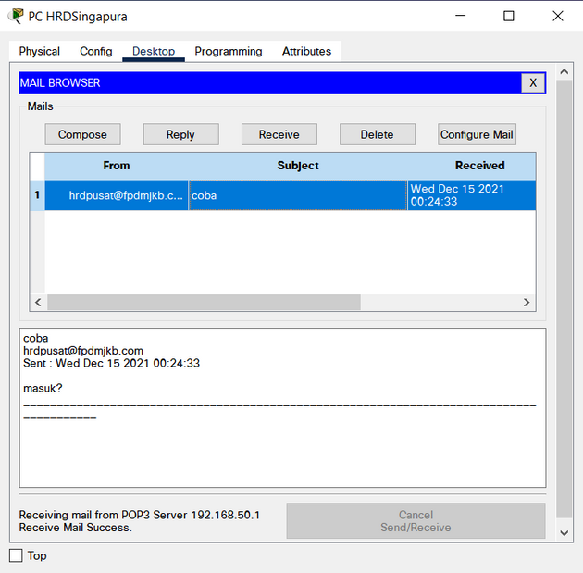
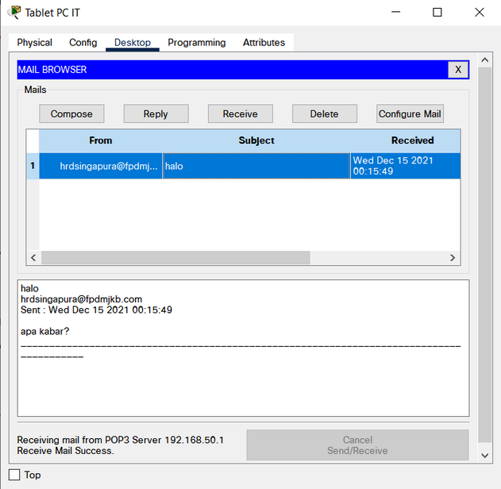
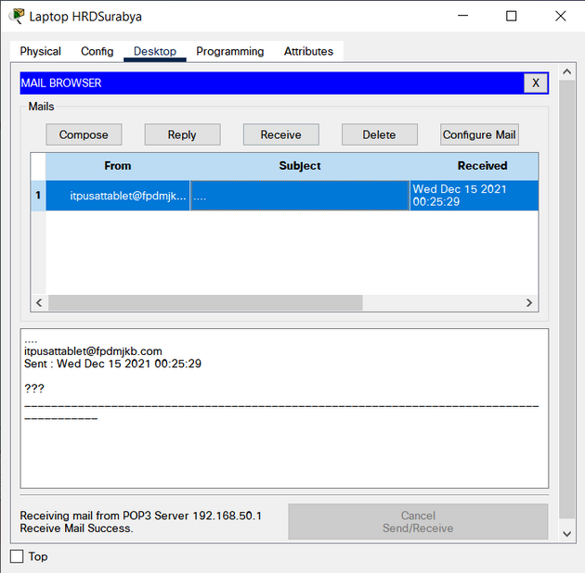
Mail Server
Berikut merupakan email yang berhasil masuk di semua device dari kantor pusat dan kantor cabang

Slide 24

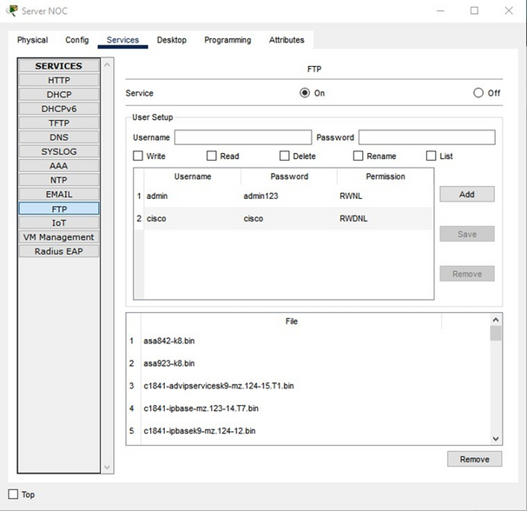
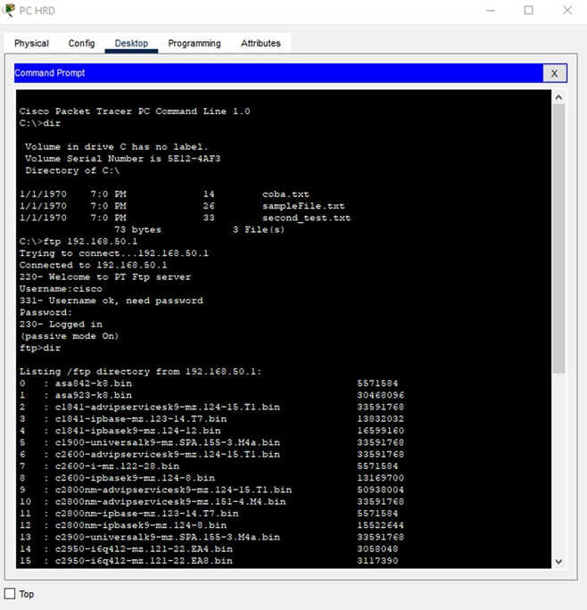

FTP (File Transfer Protocol)
FTP diatur di Server NOC dengan mengassign username, password, dan permissionnya sehingga dapat diakses oleh semua device di seluruh kantor.

Slide 25
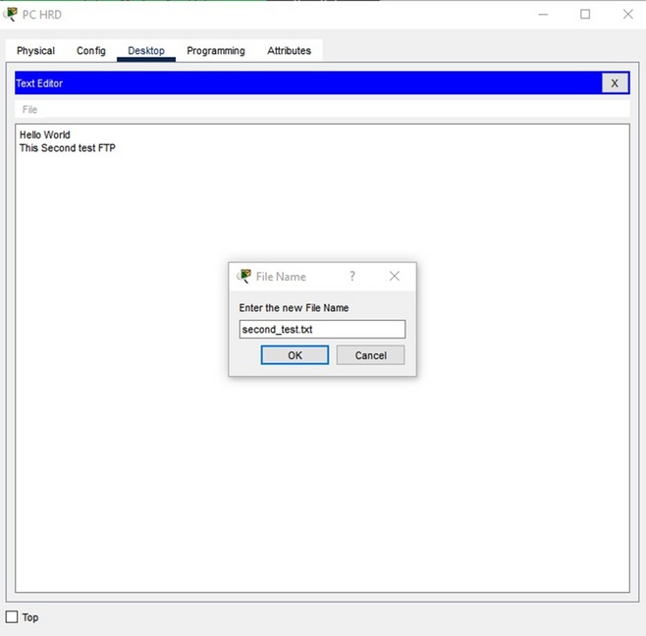
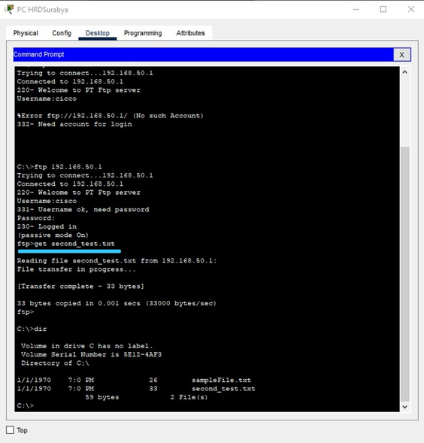
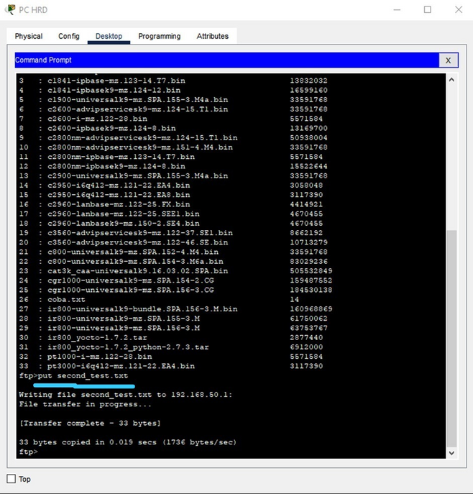
FTP
(File Transfer Protocol)
Berikut merupakan salah satu contoh FTP yang berhasil membuat file baru, memasukkan file dari pc ke server dengan perintah "put namafile" dan mengambil file dari server ke local dengan perintah "get namafile".

Slide 26

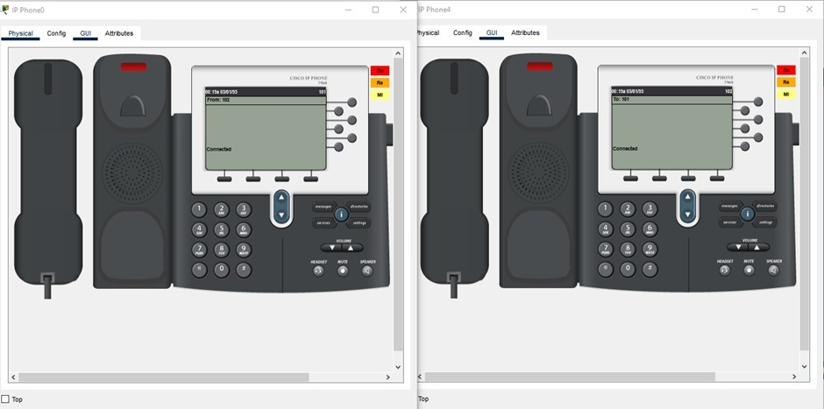
VOIP (Voice Over Internet Protocol)
Kantor Pusat
Berikut merupakan contoh VOIP antar divisi di kantor pusat berhasil terhubung

Slide 27
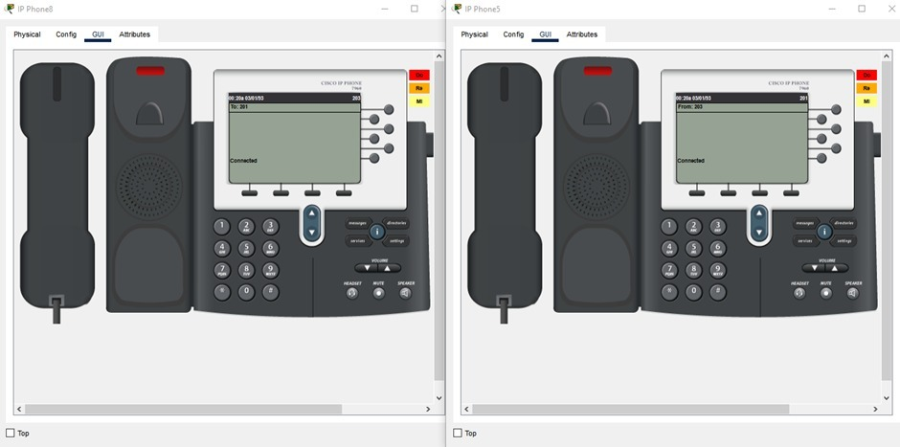
VOIP (Voice Over Internet Protocol)
Kantor Cabang Surabaya
Berikut merupakan contoh VOIP antar divisi di kantor cabang surabaya berhasil terhubung

Slide 28
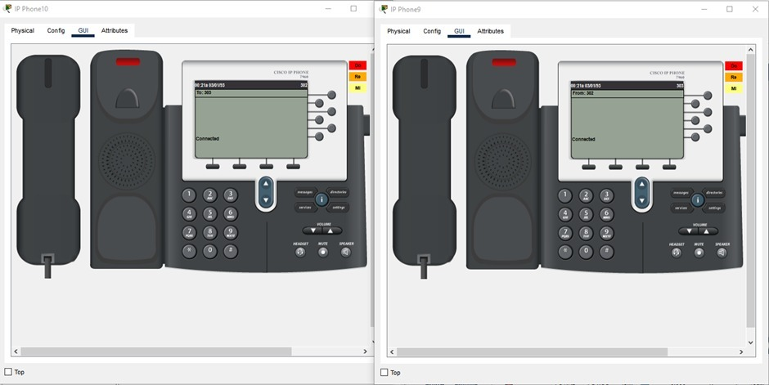
VOIP (Voice Over Internet Protocol)
Kantor Cabang Sidoarjo
Berikut merupakan contoh VOIP antar divisi di kantor cabang sidoarjo berhasil terhubung

Slide 29
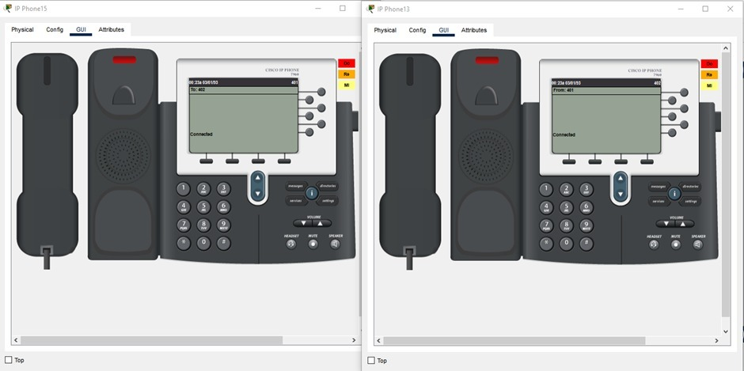
VOIP (Voice Over Internet Protocol)
Kantor Cabang Gresik
Berikut merupakan contoh VOIP antar divisi di kantor cabang gresik berhasil terhubung

Slide 30
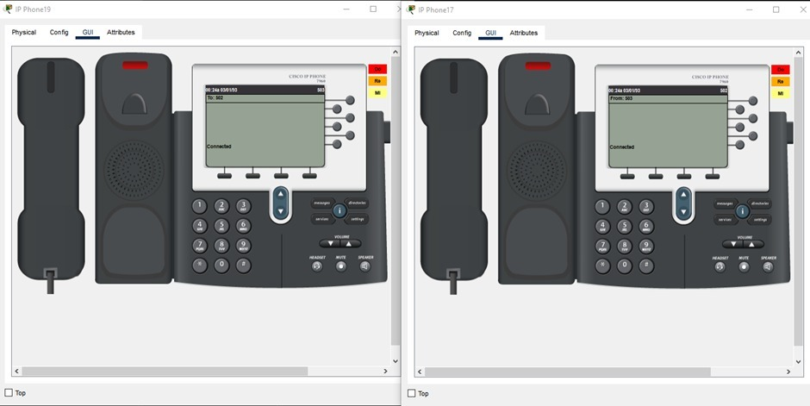
VOIP (Voice Over Internet Protocol)
Kantor Cabang Singapura
Berikut merupakan contoh VOIP antar divisi di kantor cabang Singapura berhasil terhubung

Slide 31

VOIP (Voice Over Internet Protocol)
Berikut merupakan contoh VOIP antara kantor pusat ke kantor cabang singapura berhasil terhubung

Slide 32
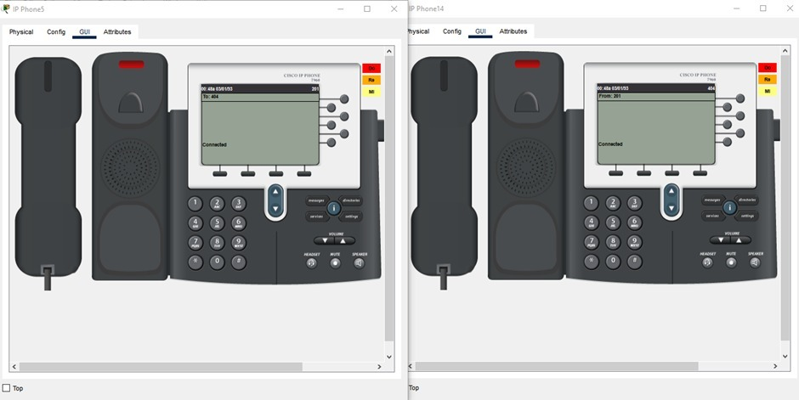
VOIP (Voice Over Internet Protocol)
Berikut merupakan contoh VOIP antara kantor cabang surabaya ke kantor cabang gresik berhasil terhubung

Slide 33
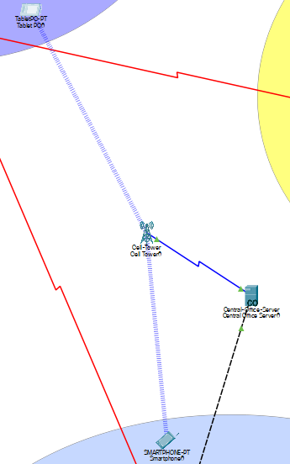
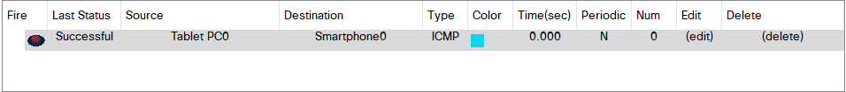
Radio
Device di kantor pusat terhubung dengan device di kantor cabang Surabaya melalui koneksi radio

Slide 34
Terima Kasih

